Slide 1
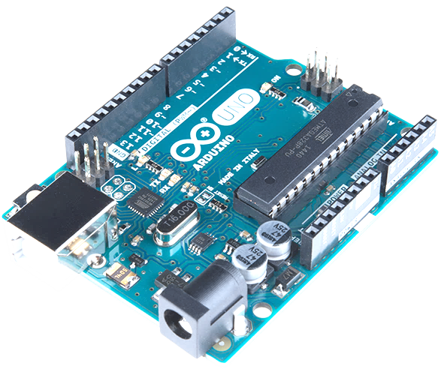


PARVATHA REDDY BABUL REDDY
VISVODAYA INSTITUTE OF TECHNOLOGY & SCIENCE

Slide 2

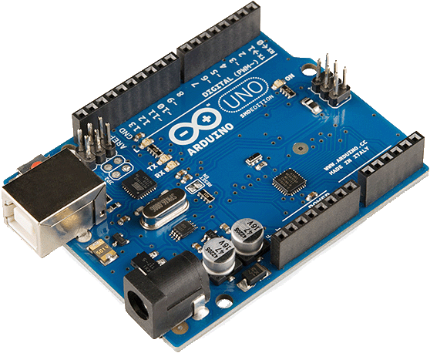

PARVATHA REDDY BABUL REDDY
VISVODAYA INSTITUTE OF TECHNOLOGY & SCIENCE
ARDUINO
PRESENTING TO YOU BY
S. JOEL MARK JOSEPH
from
3rd Year Cse –IoT 5g
21731A3541

Slide 3
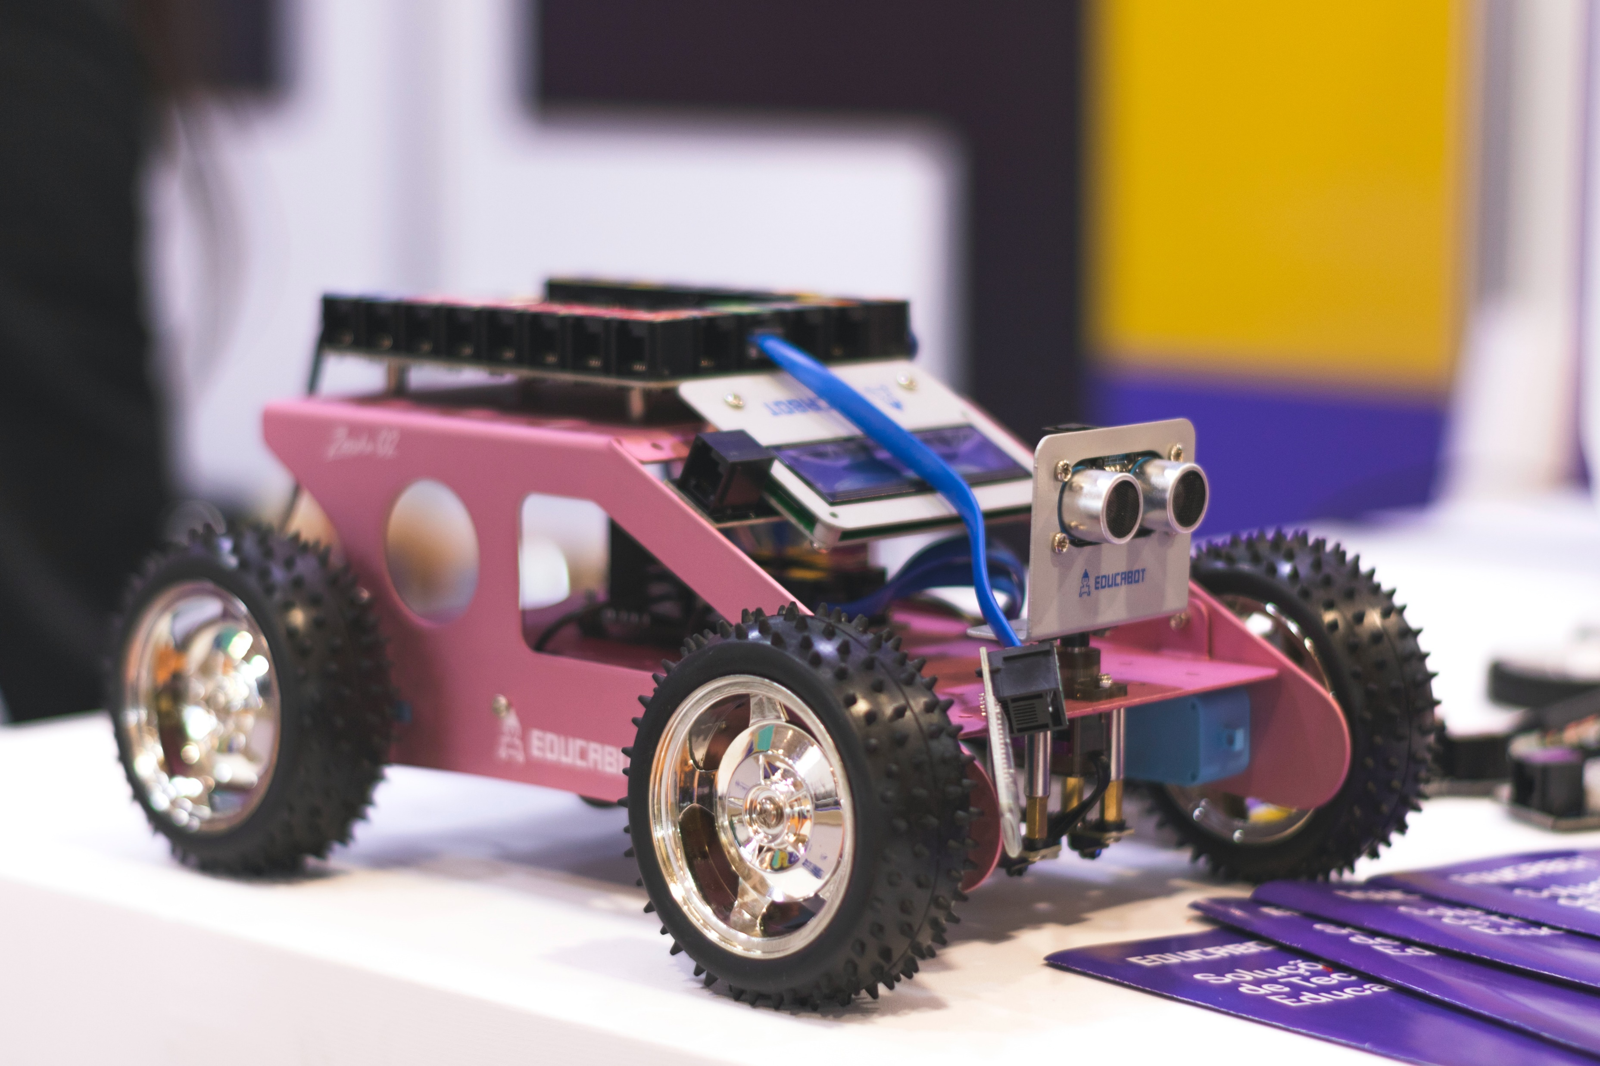

What we are going to Discuss (Abstract):
What is Arduino?
History of Arduino
Parts of Arduino
Working of Arduino
Features of Arduino
Applications of Arduino
How can we practice
Arduino without Arduino
Conclusion
ARDUINO

Slide 4
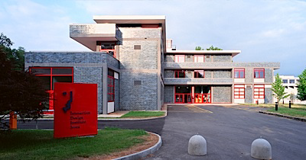
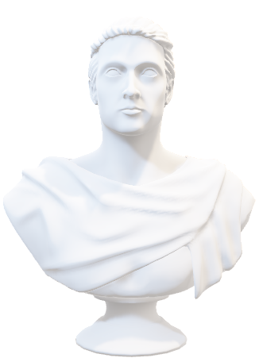
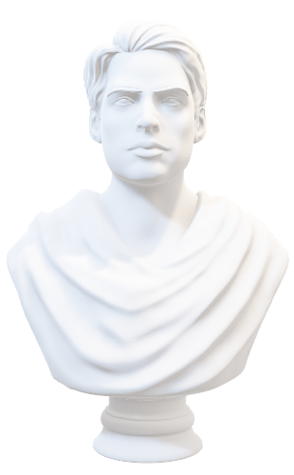
What is
ARDUINO
Arduino is an open-source electronics platform
based on easy-to-use hardware and software.
Arduino boards are able to read inputs,
light on a sensor,
activating a motor,
turning on an LED,
publishing something online etc.
ARDUINO

Slide 5
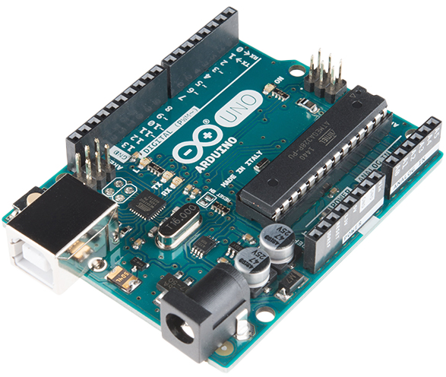
HISTORY OF
ARDUINO
The Arduino project started at the Interaction Design Institute Ivrea (IDII) in Ivrea, Italy in 2005.
Hernando Barragán (creator of Wiring), Massimo Banzi, and David Cuartielles created Arduino.
David Mellis developed the Arduino software, which was based on Wiring.
ARDUINO

Slide 6
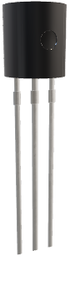
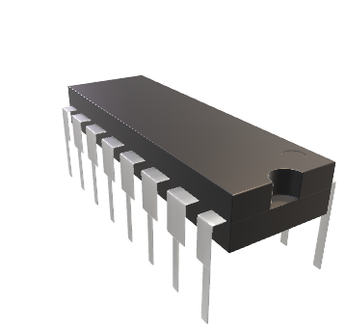
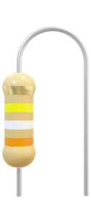
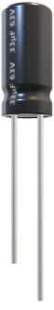
ARDUINO
PARTS OF
RX TX LEDS
DIGITAL PINS(14)
ICSP FOR ATMEGA328P
ICSP FOR ATMEGA 16U
ATMEGA 328P MICROCONTROLLER
ARDUINO
RESET BUTTON
ANALOG PINS(6)
USB-TTL CONVERTER
USB CONNECTOR
3.3V REGULATOR
POLY FUSE
DC BARREL JACK
5 V REGULATOR

Slide 7
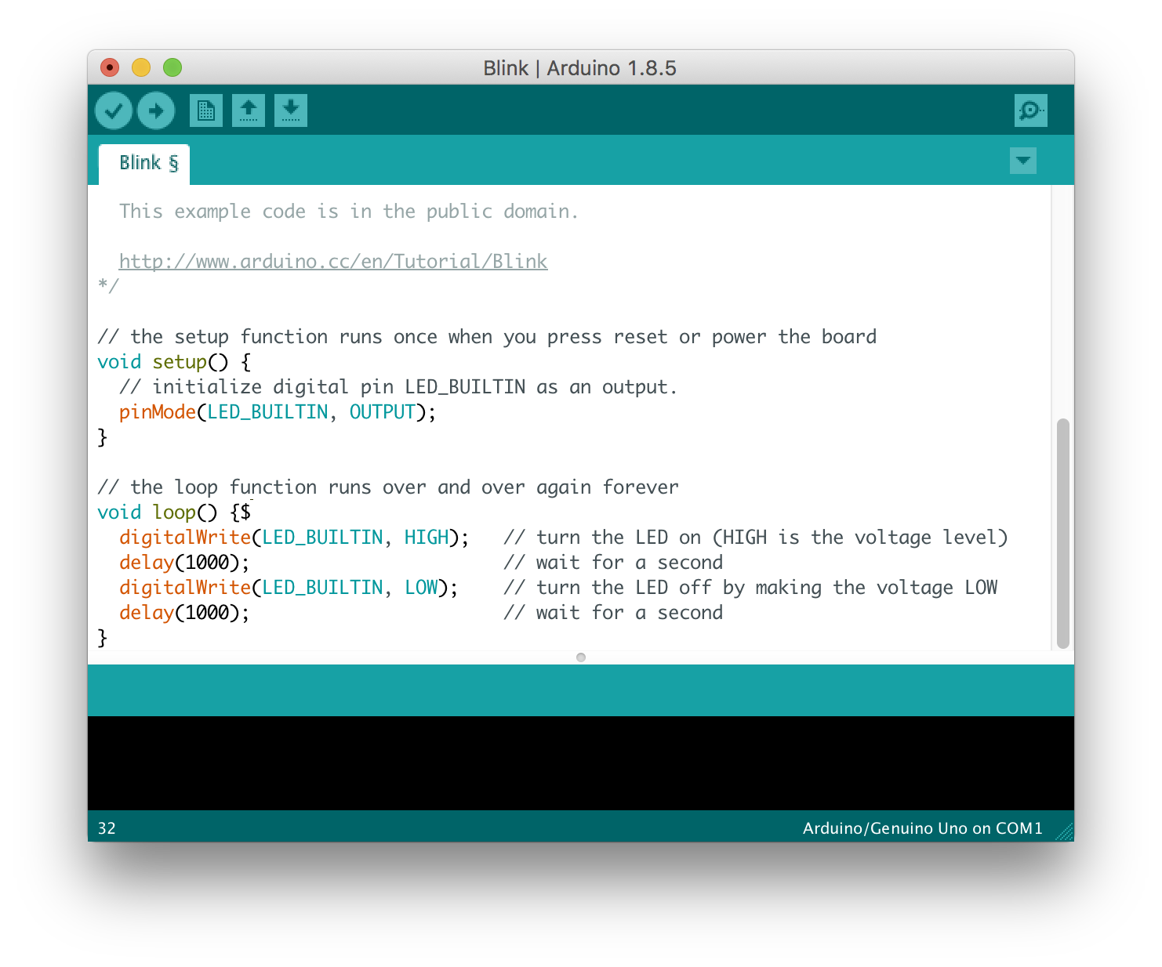
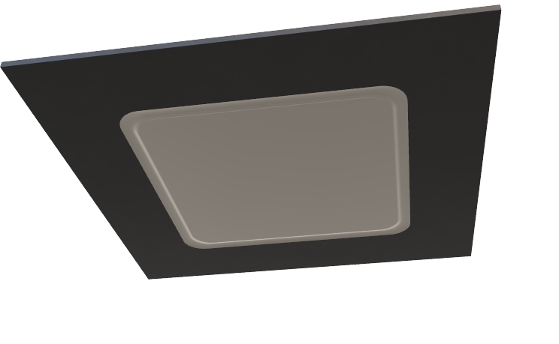
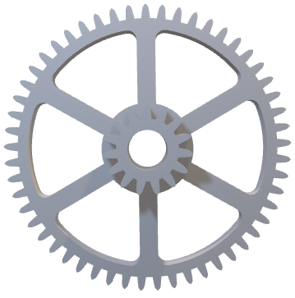
ARDUINO
HOW WORKS
Arduino consists of both a microcontroller and a piece of software, or IDE that runs on your computer, used to write and upload computer code to the physical board.
ARDUINO
PURPOSE
To Design and build devices that interact with the real world.
Provides creativity and problem-solving skills.
LED
RX TX LEDS
DIGITAL PINS(14)
ICSP FOR ATMEGA328P
ICSP FOR ATMEGA 16U
ATMEGA 328P MICROCONTROLLER
RESET BUTTON
ANALOG PINS(6)
USB-TTL CONVERTER
USB CONNECTOR
3.3V REGULATOR
POLY FUSE
DC BARREL JACK
5 V REGULATOR

Slide 8

ARDUINO
HOW WORKS
LED
RX TX LEDS
DIGITAL PINS(14)
ICSP FOR ATMEGA328P
ICSP FOR ATMEGA 16U
ATMEGA 328P MICROCONTROLLER
RESET BUTTON
ANALOG PINS(6)
USB-TTL CONVERTER
USB CONNECTOR
3.3V REGULATOR
POLY FUSE
DC BARREL JACK
5 V REGULATOR

Slide 9
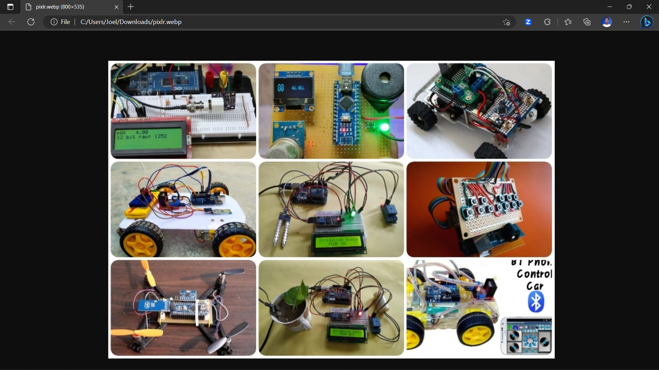
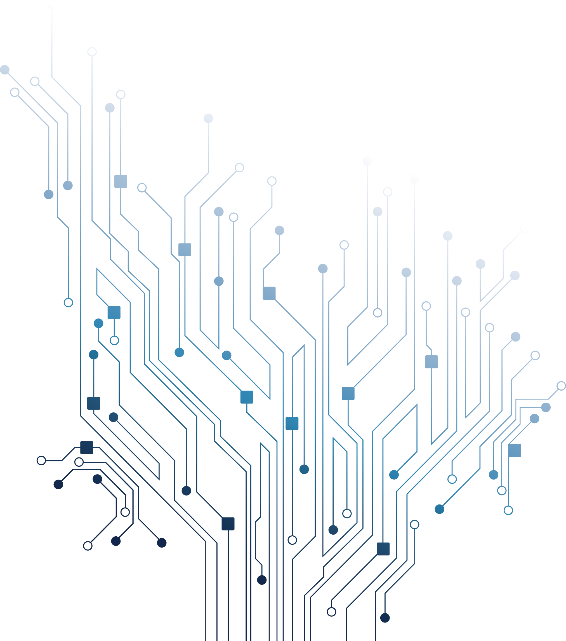
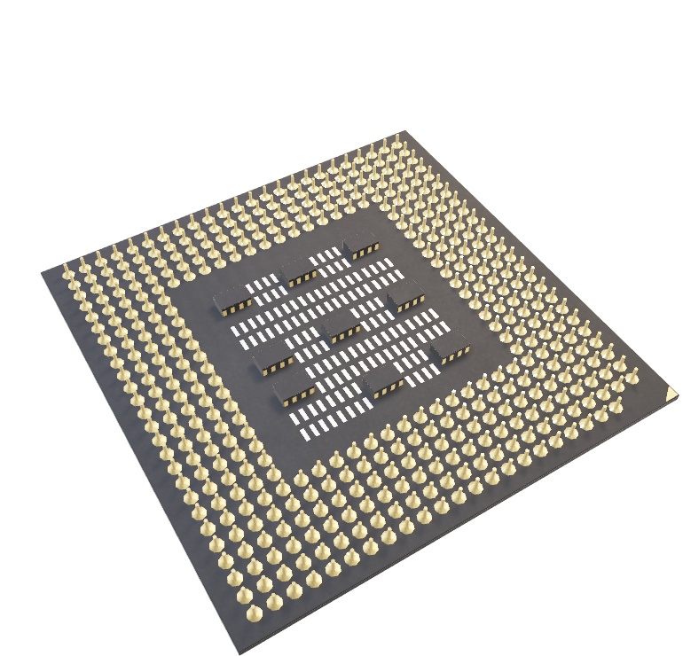
FEATURES OF UNO
Inexpensive Hardware
Active User Community
Cross Platform Support
Tons of Libraries
Faster Execution
User Friendly
Customizable
ARDUINO
ARDUINO

Slide 10
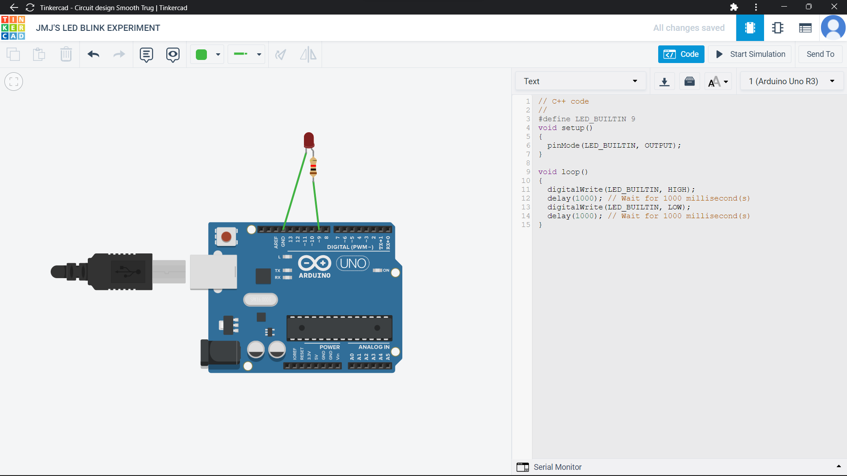
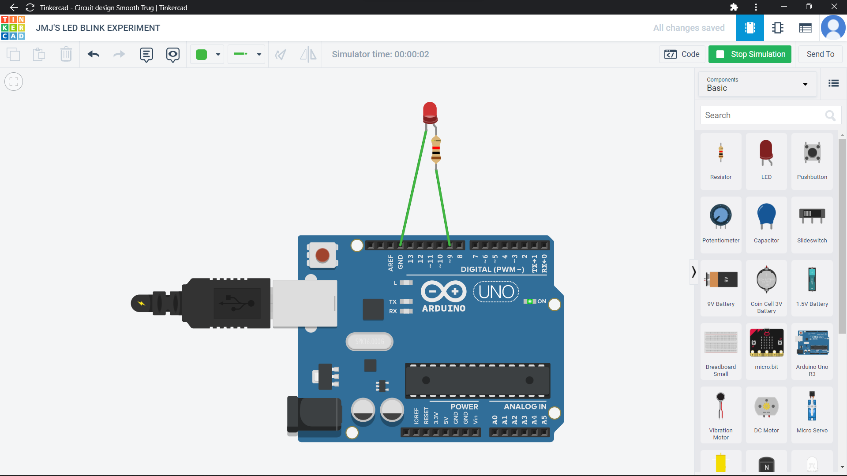
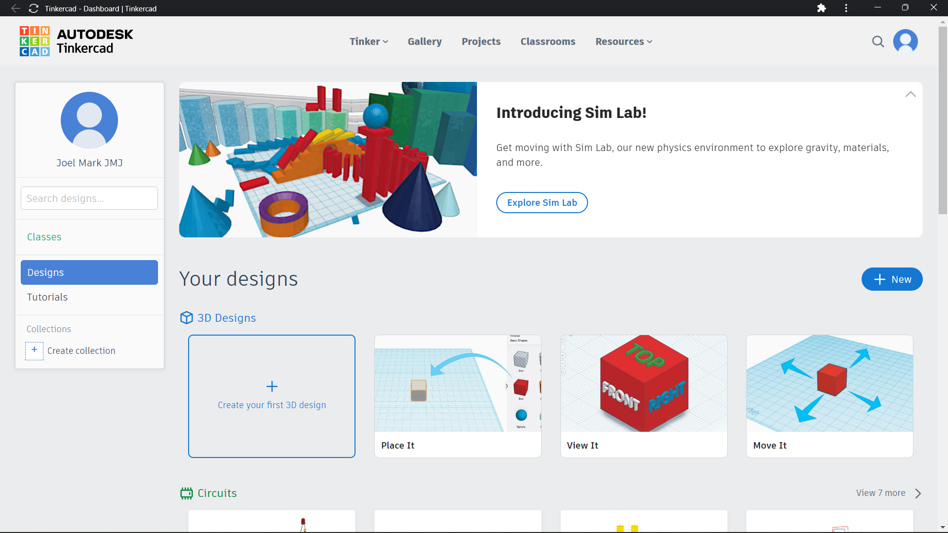
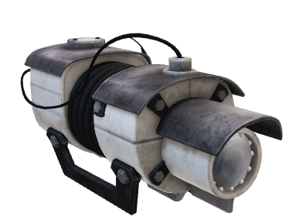
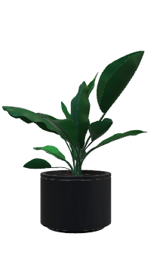
HOW CAN WE PRACTICE WITHOUT ARDUINO
ARDUINO
APPLICATIONS OF IN IOT
Smart Homes
Defense
Industries
Traffic Signal control
Medical
Laboratories
Body Control with Arduino
Aerospace
Automatic Vehicle Control etc.
Examples:-
Obstacle Avoidance Robot – as Mini Project
Plant Communicator
Motion following Security Camera
ARDUINO

Slide 11
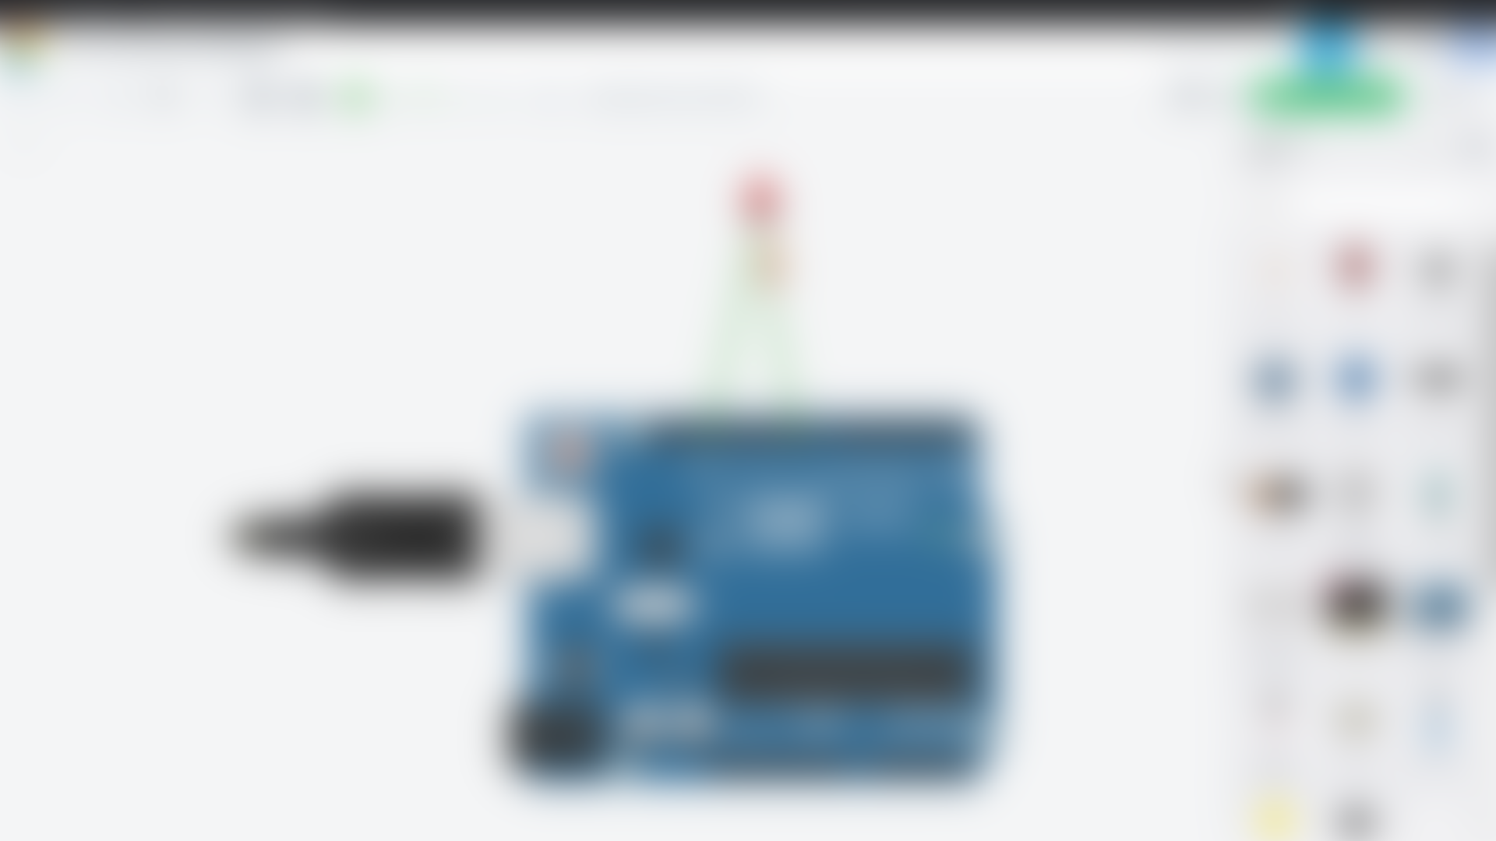


TINKERCAD
ARDUINO
HOW CAN WE PRACTICE WITHOUT ARDUINO

Slide 12
ARDUINO
HOW CAN WE PRACTICE WITHOUT ARDUINO
TINKERCAD

Slide 13
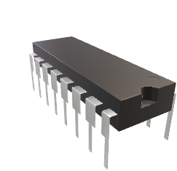
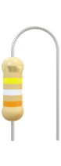

CONCLUSION
Arduino is such an user friendly Board with which we can connect many devices and automate them.
Arduino is a Budding Technology Now-a-days.
Arduino Uno Changes our Sweet Home to Smart Home.
Arduino Bagged a vast applications in real life activities.
Tinkercad is used to Test our code with virtual circuits.
Finally, Arduino got Embedded in every Humans daily Life.
ARDUINO

Slide 14
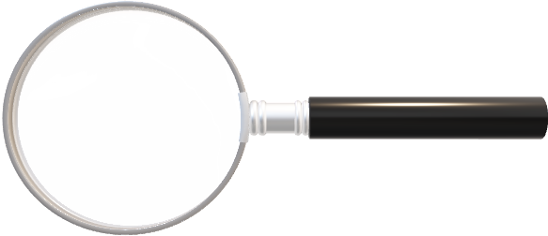

ANY QUERIES ?
GUYS

Slide 15


